Slide 1

DECISION TREE
-- Mounika Voriganti

Slide 2
Decision Tree algorithm
Belongs to the family of supervised learning algorithms. Unlike other supervised learning algorithms, the decision tree algorithm can be used for solving regression and classification problems in the form of a tree structure.
The final result is a tree with decision nodes and leaf nodes. A decision node has two or more branches.
Leaf node represents a classification or decision.

Slide 3
Root Node: It represents the entire population or sample and this further gets divided into two or more homogeneous sets. Decision Node: When a sub-node splits into further sub-nodes, then it is called the decision node. Leaf / Terminal Node: Nodes do not split is called Leaf or Terminal node.

Slide 4
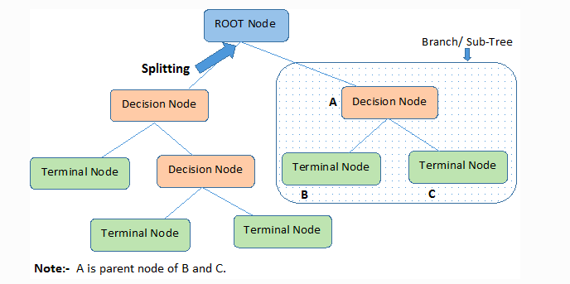

Slide 5
Entropy
This is a measure of the randomness in the information being processed. The higher the entropy, the harder it is to draw any conclusions from that information.
Information gain
This is used for determining the best features/attributes that render maximum information about a class. Entropy - Entropy is the measurement of impurities or randomness in the data points. It basically ranges between 0-1. 0- Pure, 1-Impure

Slide 6
Process of selecting root node in ID3
Find the Information gain of the target attribute.
Find the Entropy of rest attributes.
Find gain for each and every rest attribute.
Gain = IG – Entropy
The attribute that has highest gain will be selected as root node.

Slide 7
Gini Index/Gini purity
It measures the impurity of the nodes. ranges between 0-1.
Gini Index/Gini Impurity = 1-Gini
1 - (/Sum of squred propability of each class)
0 - Data points/feature are pure. Eg. All Yes
1 - Data points/feature are impure(Randomness) eg. Yes, No both
0.5 - Equal distribution of classes. 5 yes, 5 no
Gini ranges from zero to one, as it is a probability and the higher this value, the more will be the purity of the nodes. lesser value means lesser pure nodes. 1 - pure, 0 – randomness
Gini works only in those scenarios where we have categorical targets. It does not work with continuous targets. attribute having least gini impurity value will be selected as root node.

Slide 8
Pruning
Pruning is one of the techniques that is used to overcome problem of overfitting in decision tree. Pruning is the process of reducing the size of the tree by turning some branch nodes into leaf nodes, and removing the leaf nodes under the original branch.
It reduces the size of a Decision Tree which might slightly increase training error but drastically decrease your testing error, hence making it more adaptable.

Slide 9
Thank you

